Slide 1



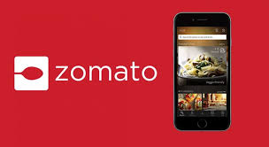


PRODIFY
Product Management Case Comp
Team SORTED, T. A. Pai Management Institute, Manipal
Kajal Gupta (Team Leader)
INCREASE AVERAGE REVENUE PER USER
Should Zomato venture to Grocery or Cloud Kitchen?
Mohit Kiradoo
Devesh Sinha

Slide 2




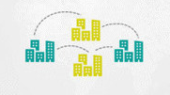
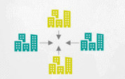



About the sector & Hypotheses
Hypotheses from Financial POV
Evaluating System Integrations
Go To Market Strategy
STP &
Marketing Mix
Go To Market Strategy(App)
Success Metrics
Press Release
ONLINE GROCERY MARKET
CLOUD KITCHEN MARKET
Market will ACCELERATE at a CAGR of
20.52%
Growth for 2022
19.20%
Estimated Market Size
$1.05B
Growth rate
12%
Incremental growth($B)
4.74
The market is CONCENTRATED with few players occupying the market
Addressed Market
$84Mn
The market is FRAGMENTED with one established player(REBEL FOODS) and multiple small players
Grocery being considered as essential items, has a stagnant demand, with small upticks observed throughout the year. Hence, the demand for grocery items can be considered to be linear in nature.
Food & Beverages industry runs on convenience and availability. Significant surge in demand in observed on multiple occasions like weekends, long holidays, festivals. Many restaurants have reported considerable profits even after almost no sales on normal working days. Hence, the demand is driven by seasonality.
Hence from the nature of demand POV, Zomato’s venture into cloud kitchen should be considered over grocery.
Arun Kumar
Working Professional, 27 yr
After a long day at office, forgets to buy a pack of Amul Taaza from a local store. Gets back home, looks to order the same from online grocery business. Does not find it on Big Basket, switches to another app finds it there and orders it.
After finishing off his office schedule, gets back home early. Is in no mood to cook food, instead looks to order some good food online. Opens Zomato and scrolls for what he should order. Chooses a bestseller after minutes of thinking, and places the order.
Inference: Grocery items being essential, user choices are very specific. Hence users are more likely to switch platforms, if not available.
Inference: At the top of their mind, users usually do not have what they would like to have. Hence, choices are more driven by availability and price.
Hence from the consumer behaviour POV, Zomato should venture into cloud kitchen rather than grocery.

Slide 3


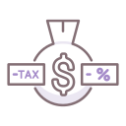

About the sector & Hypotheses
Hypotheses from Financial POV
Evaluating System Integrations
Go To Market Strategy
STP &
Marketing Mix
Go To Market Strategy(App)
Success Metrics
Press Release
ONLINE GROCERY MARKET
CLOUD KITCHEN MARKET
Fixed Costs |  | Assumptions
Hub setup | ₹ 4000000 | Assuming ₹2000 per sqft and minimum space requirement is 2000sqft
Staff cost | ₹ 72000 | Each hub would require 3-4 people who sort out products at the hub. Considering the minimum wage of ₹18000
Delivery cost | ₹ 50 | Approximate costs incurred for delivering around a 5km radius
Fixed Costs |  | Assumptions
Rent | ₹ 1600000 | Cloud kitchen spaces are mostly leased. Assuming ₹2000 per sqft and space requirement is typically around 800 sqft. This is sufficient to accommodate 10-12 brands.
Licenses | ₹ 15000 | FSSAI, Health Trade, Tax Registration Licenses. Ensures better quality control
Kitchen & Equipment | ₹ 1000000 | For kitchen setup and kitchen equipment required depending on the type of cuisine
Staff | ₹ 70000 | Considering the wages of Head Chef, Sous Chef and other support staff
Based on the above cost structure, the fixed costs are relatively higher for online grocery due to requirement of large spaces, while in case of cloud kitchen 800 sqft of space is enough to accommodate 10-12 brands. Also, automation and AI techniques can be used to optimize costs and reducing staff requirements in case of cloud kitchen.
Average Order Value(AOV)
₹ 250
Average Purchase frequency
2-3 times per week
Average Order Value(AOV)
₹ 400
Average Purchase frequency
4 times per week (even higher during festivals or holidays)
Hence, the average revenue per user is comparatively much higher in case of food & beverages as compared to groceries.
Average net profit 2.2%
EBIT
4-8%
Average net profit 10%
EBIT
15-20%
Margins in grocery industry are very low, with most of the demand being driven by discounts. Also, inventory plays an important role in providing the service. Shortage of any particular product even an SKU, leads to a bad customer experience.
Typically, food industry has very high margins. Consider, a use case of making a Margherita Pizza. The cost incurred to make is typically around ₹ 55-57, while it is sold at approximately ₹ 200, almost 4X. Operational efficiency(EBIT) can be improved by implementing tech equipment like automatic fryers, smart refrigerators, etc.
Low profit margins and low EBIT, make investments in grocery unfeasible.
Zomato should allow Blinkit to operate the grocery business model and instead venture into cloud kitchen which has higher scalability in order to make a profitable business.

Slide 4
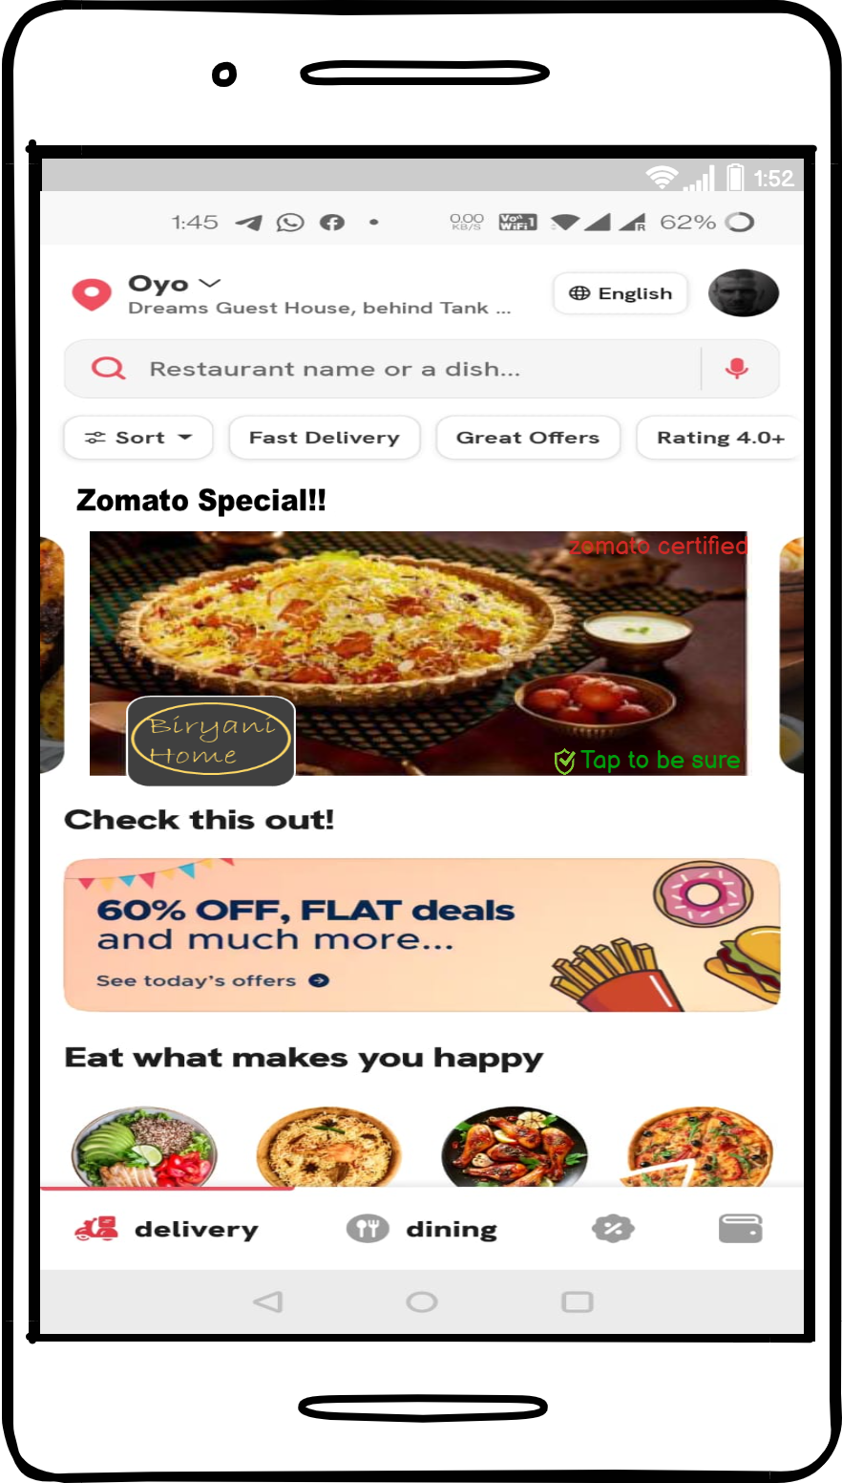
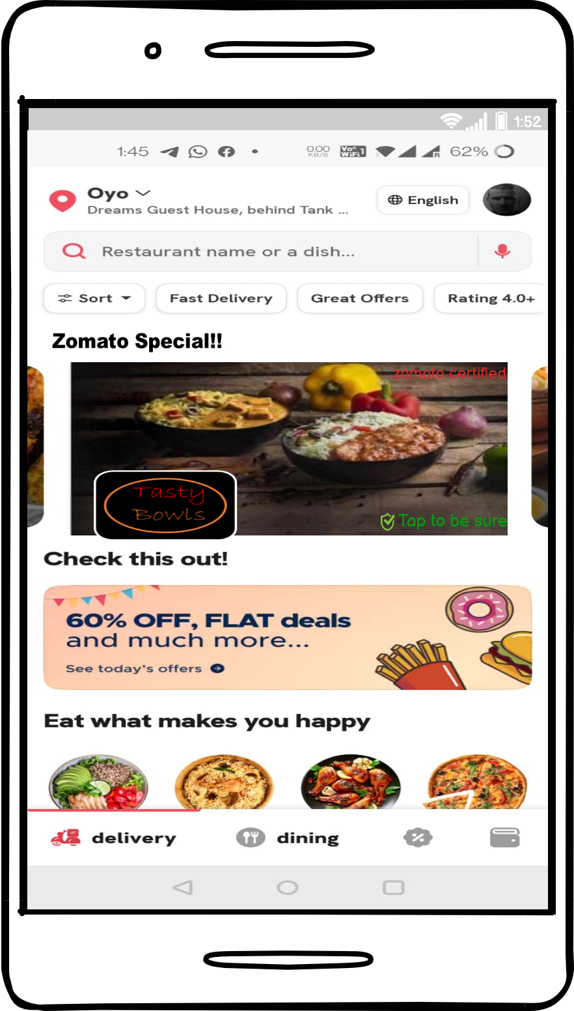




About the sector & Hypotheses
Hypotheses from Financial POV
Evaluating System Integrations
Go To Market Strategy
STP &
Marketing Mix
Go To Market Strategy(App)
Success Metrics
Press Release
1
Introducing a new app for Zomato’s Kitchen
Challenges:
Awareness about the new app being launched, time taking process
High Customer Acquisition Cost(CAC)
Development and Promotional costs related to launching of a new app
Challenges with respect to integration with new system
Failure of Swiggy Daily:
Swiggy Daily was largely targeted at users who look for healthy home-cooked food at an affordable price point. It allowed users to choose three days to a month-long subscription.
The app never gained traction owing to the low awareness about the new app which resulted in weak demand, that even plummeted due to the black swan event.
2
Integrating Zomato’s Kitchen as Zomato Special in the existing app
UI Changes recommended for integration
Zomato’s Cloud Kitchen Special Cuisines to be listed here
Wider reach with existing customer base
Low Customer Acquisition Cost(CAC)
Zomato hygiene certified tag
Low integration cost incurred
In App promotions

Slide 5
About the sector & Hypotheses
Hypotheses from Financial POV
Evaluating System Integrations
Go To Market Strategy
STP &
Marketing Mix
Go To Market Strategy(App)
Success Metrics
Press Release
Polygon Mapping
Discovering areas with low restaurant coverage or lower # of outlets in a 5-10km radius
Supply demand gap in food delivery
Demand Forecasting
Passive Demand Forecasting using historical sales data
Short-term projections for next 3-12 months
Selection of cuisines
Areas chosen
Food tastes
Building Brands
Conveying a differentiated factor in each cuisine
Customer perception for each specific cuisine as a separate brand/entity
Long term projections for next 4-5 years
Internal business forecasting
Consumer preferences
Specific cuisines having high demand

Slide 6
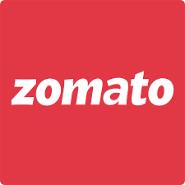






About the sector & Hypotheses
Hypotheses from Financial POV
Evaluating System Integrations
Go To Market Strategy
STP &
Marketing Mix
Go To Market Strategy(App)
Success Metrics
Press Release
Demographic Segments | Profile | Participation Rate* | Targeting | Positioning
PG/ Hostel dwellers | Shares room with 2 to 4 people or even live individually Cooking tendency low, skip meals often Instant food and takeaways are their favorite Always hunt for food that is available with less effort | 30% | Monitor order frequency of the users and target the population in each segment most vulnerable to ordering food online. Existing database of Zomato can be leveraged for implementing the strategy.
Young married couples | Not very keen on cooking Prefer to spend quality time with family and friends High on entertainment quotient and takeaways Prefer to taste food from various outlets on regular basis | 40%
Working wives | Both partners working, experience time crunch Earn decently and spend a major share of their income on food and entertainment Frequent takeaways are frequent, about 2–4 times in a week | 40%
Students | Mostly in their teens and majorly stay in hostels Do not prefer meals from college canteens, often skip it Ordering food via apps is high on their agenda | 50%
Hardcore foodies | First to try new restaurants and love boasting about their food knowledge to friends and family Earn a decent salary and love to spend a major percentage on food Like to attend college food fest, restaurants and cookery channels | 60%
From secondary research, two most important variables identified for positioning Zomato’s Cloud Kitchen are Hygiene and Affordability
Affordability
Hygiene
Value Proposition:
You asked for it, we did it: Zomato Cloud Kitchens are handcrafted in a way that brings to you the most affordable, tastiest and hygienic food in just no time!
MARKETING MIX
Biryani Home
Tasty Bowls
Mealbox
Sweet Tooth
Biryani Home: 179
Tasty Bowls: 159
Mealbox: 199
Sweet Tooth: 99
Tier 1 cities
& high student populated cities(Manipal)
In-app promotions
Press Release
Online orders
Feedback received from customers
Delivery partners
Creative Packaging
*Population base is considered to be Tier 1 and Tier 2 cities, and the participation rate is estimated accordingly from market research reports

Slide 7
About the sector & Hypotheses
Hypotheses from Financial POV
Evaluating System Integrations
Go To Market Strategy
STP &
Marketing Mix
Go To Market Strategy(App)
Success Metrics
Press Release
Feature Development
A/B Testing
Improvement
Awareness
Release
Proposed Feature to be developed by the development team in collaboration with Product Owner and tested thoroughly by QA team.
Feature to be rolled out during pilot project and outcomes and relevance to be observed
Improvements to be made based on responses received by user groups
Increasing visibility across platforms with the posts on their social handle.
Features like Play along would help more engagement among the audience.
Final release of the product after addressing the modifications and bugs

Slide 8
About the sector & Hypotheses
Hypotheses from Financial POV
Evaluating System Integrations
Go To Market Strategy
STP &
Marketing Mix
Go To Market Strategy(App)
Success Metrics
Press Release
Product Initiatives
KPI
Dimension
North Star Metric
User activation
Product Trials
# of users placing order
Breadth
Number of Successful food items deliver each week
Recommendations
Discounts
Cart list
# of items per order
Depth
Flash sales
Push-Notifications
# of orders per user per week
Frequency
Automated replacements
Zomato Support
Logistics
% of orders delivered on time
Efficiency
Average Duration Spent
Tracking time spent by user in the section will enable understand user likelihood of conversion
# of clicks/impressions
Daily/weekly tracking would enable tracking # of users accessing the feature
Drop-off Rates
High Drop-off rates would show low interest in the feature
Bounce Rate & Retention Rate
Decrease in Bounce rate shows more engagement of customers and increase in the # of orders exhibits Retention
CTRs of new feature
Daily/weekly tracking would enable tracking of user engagement with the features
Increase in # of app downloads
Will show new Customer acquisitions post launch

Slide 9
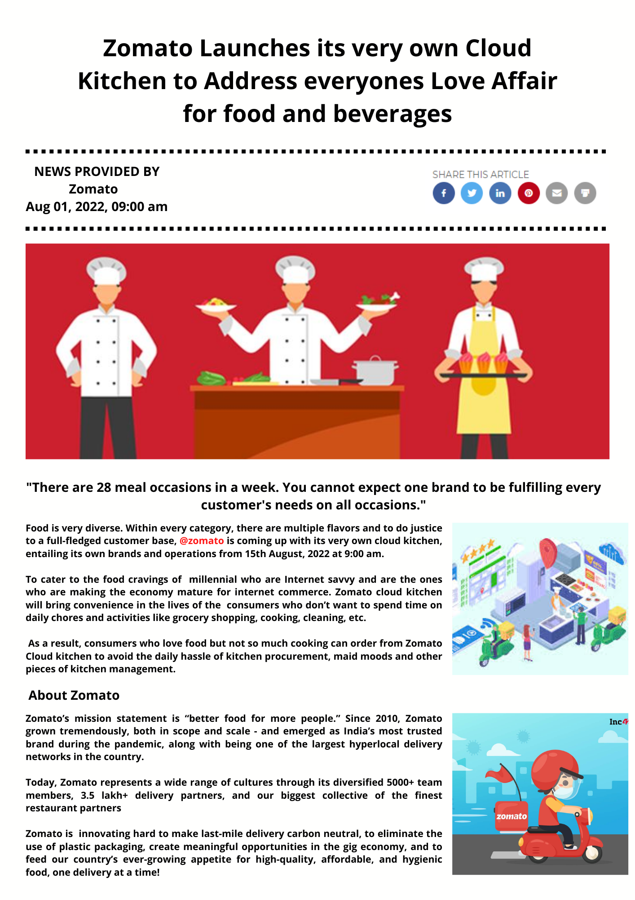



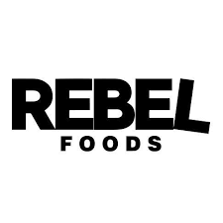
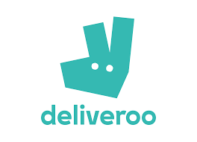


About the sector & Hypotheses
Hypotheses from Financial POV
Evaluating System Integrations
Go To Market Strategy
STP &
Marketing Mix
Go To Market Strategy(App)
Success Metrics
Press Release
SERVICE POSITIONING
Owned Operations
DARK KITCHEN
KITCHEN AS A SERVICE
Own Brands
3rd Party Brands
VIRTUAL KITCHEN
KITCHEN AGGREGATOR
Outsourced Operations

Slide 10
Computer Ji!
Kitchen pe taala lagaya jaaye.
Thank you
order food online on zomato

